Slide 1



Using GIS Technology for Social Impact University of Southern California
Noah Sager
Product Engineer | ArcGIS API for JavaScript | Esri
@noashx
nsager@esri.com
Notes:
Notes on these slides created by Noah Sager (current as of 02/11/2019)
https://noashx.github.io/presentations/USCLA/USCLA_Lecture_Sager.pptx
https://noashx.github.io/presentations/USCLA/USCLA_Lecture_Sager.pdf

Slide 2
Agenda
Who am I?
What are we talking about?
GIS apps
A tad o’ data
Career Opportunities
Notes:
Business

Slide 3



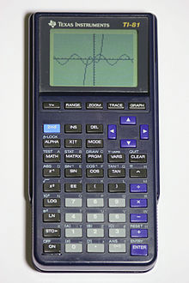


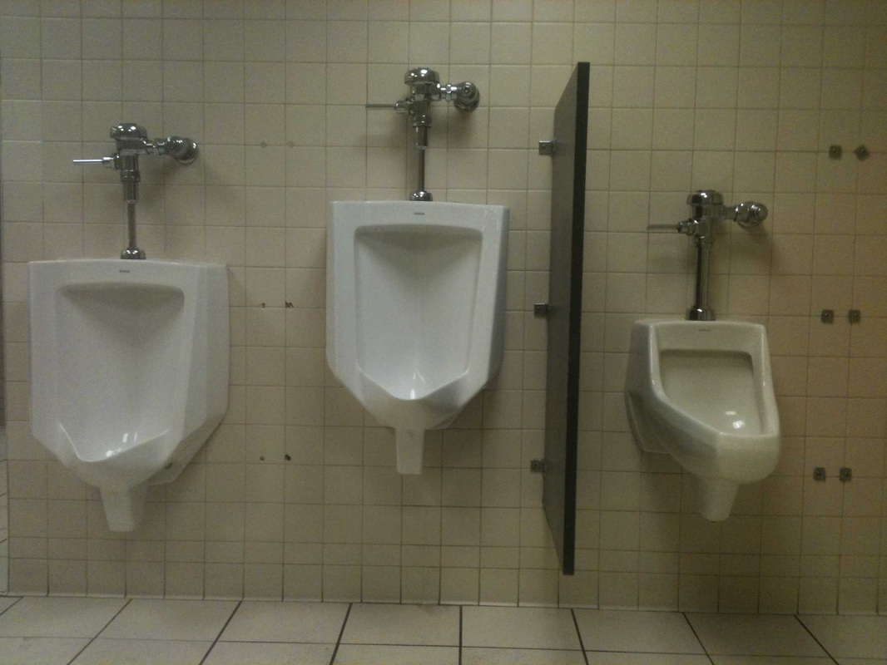

Notes:
A little about me:
First programming experience was on a TI-81 in high school. Made a few games.
Beautiful son
Beautiful daughter
Patriots fan since they drafted drew bledsoe in 1993
Studied squirrel foraging and anti-predator behavior in undergrad
Took a GIS approach to public restroom access in grad school
Before I came to esri they used my picture on promotional material, then after I grew a beard they hired me full time
And of course, I love working with computers

Slide 4

What is…
Geography?
Notes:
Before we jump into the presentation, let’s talk about Geography, GIS, and ArcGIS. We want to figure out as a group where we are at on the following topics.
Ask the group…
What is….
Geography?
GIS?
ArcGIS?

Slide 5
Everything is related.
Things that are closer are more related than things that are farther away.
Notes:
Simple, clear, definition. Tobler’s first law of Geography.
https://en.wikipedia.org/wiki/Tobler%27s_first_law_of_geography

Slide 6
What is…
Geography?
GIS?
Notes:
Before we jump into the presentation, let’s talk about Geography, GIS, and ArcGIS. We want to figure out as a group where we are at on the following topics.
Ask the group…
What is….
Geography?
GIS?
ArcGIS?

Slide 7
Geographic Information System (GIS) lets us visualize, question, analyze, and interpret data to understand relationships, patterns, and trends. GIS benefits organizations of all sizes and in almost every industry.
Notes:
Dictionary definition

Slide 8
GIS is a tool/science/technology that collects, analyzes, and visualizes spatial relationships on a computer*.
Notes:
Working definition

Slide 9
What is…
Geography?
GIS?
ArcGIS?
Notes:
Before we jump into the presentation, let’s talk about Geography, GIS, and ArcGIS. We want to figure out as a group where we are at on the following topics.
Ask the group…
What is….
Geography?
GIS?
ArcGIS?

Slide 10
ArcGIS is an Esri GIS solution.
Desktop (Windows, Mac, Linux)
Mobile (Android, iOS, Windows)
Web (Chrome, IE, Opera, etc.)
Embedded (Car, Fridge, etc.)
Notes:
ArcGIS is an Esri GIS solution.

Slide 11

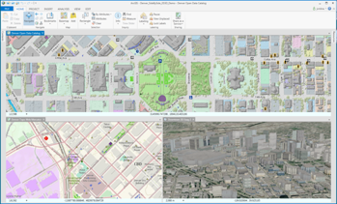
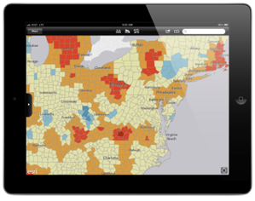
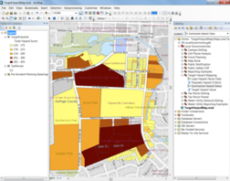
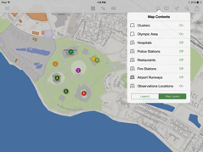
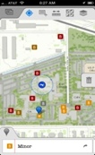
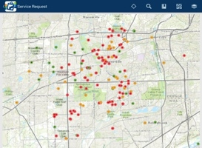


The ArcGIS Platform
ArcGIS Desktop
Apps
APIs & SDKs
http://
http://
http://
Maps
Scenes
ArcGIS Enterprise
(ArcGIS Server +
Portal for ArcGIS)
ArcGIS Online
Analytics
Feature
Layers
Scene Layers
Tile
Layers
Image
Layers
Analytics
Services
Data
Notes:
The ArcGIS Platform
All of this data is exposed through the geoinformation model as items that users and apps can work with.
These items are delivered by ArcGIS Online or ArcGIS Server.
Both have a portal that make these information items available to users.
The Apps, Desktop, APIs, and SDKs are all powered by this information.
All of this rests on a bed of services and data. The apps and users interact directly with the information from these services.
Today, we are focusing on the APIs & SDKs, specifically, the ArcGIS Runtime SDK for .NET.

Slide 12
What is…
Geography?
GIS?
ArcGIS?
GIS Programming?
Notes:
Before we jump into the presentation, let’s talk about Geography, GIS, and ArcGIS. We want to figure out as a group where we are at on the following topics.
Ask the group…
What is….
Geography?
GIS?
ArcGIS?

Slide 13
GIS Programming is a
kickbutt way to solve
geospatial problems and forward social causes in
a creative and totally relevant/unique workflow.
Notes:
If location matters, and programming is cool, then…

Slide 14

https://developers.arcgis.com
Notes:
https://developers.arcgis.com/

Slide 15
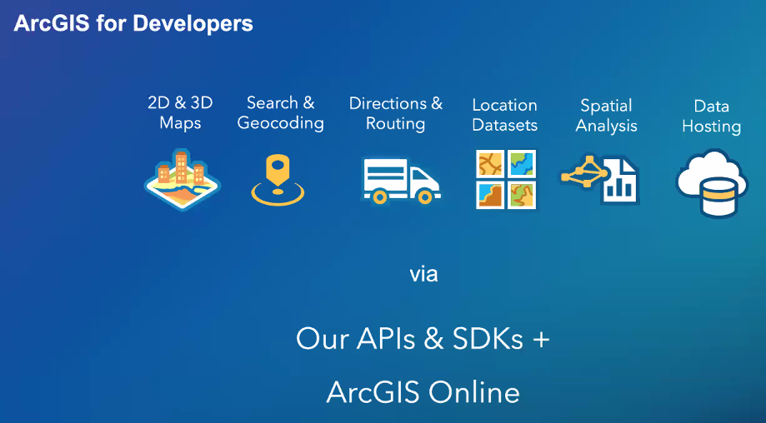
Notes:
https://developers.arcgis.com/

Slide 16
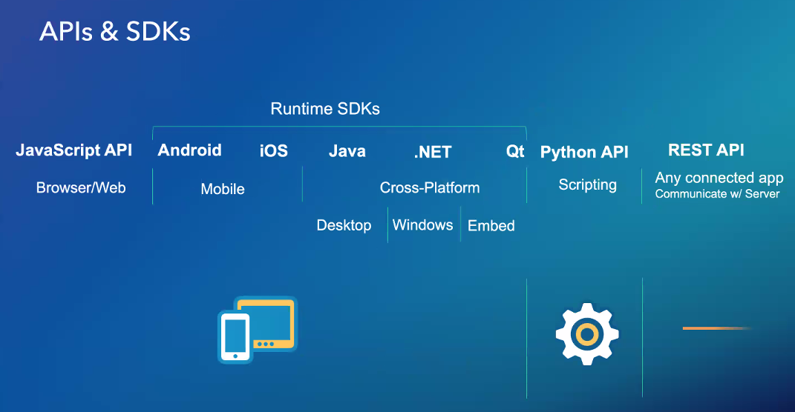
Notes:
https://developers.arcgis.com/

Slide 17
So what?

Slide 18
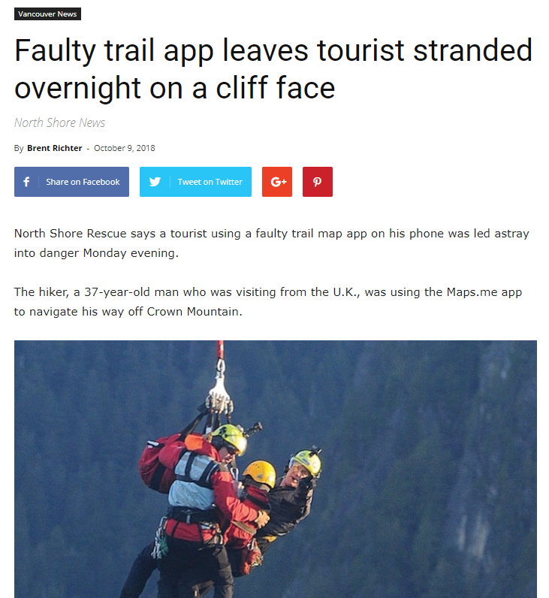
Notes:
https://www.vancouverisawesome.com/2018/10/09/tourist-app-stranded-crown-mountain-north-vancouver/

Slide 19
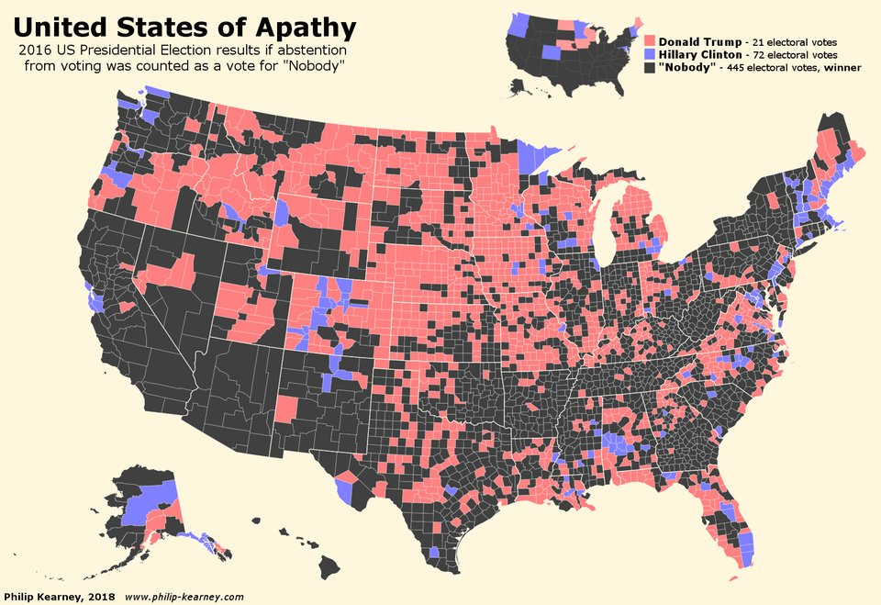
Notes:
https://twitter.com/simongerman600/status/990908747231920128

Slide 20
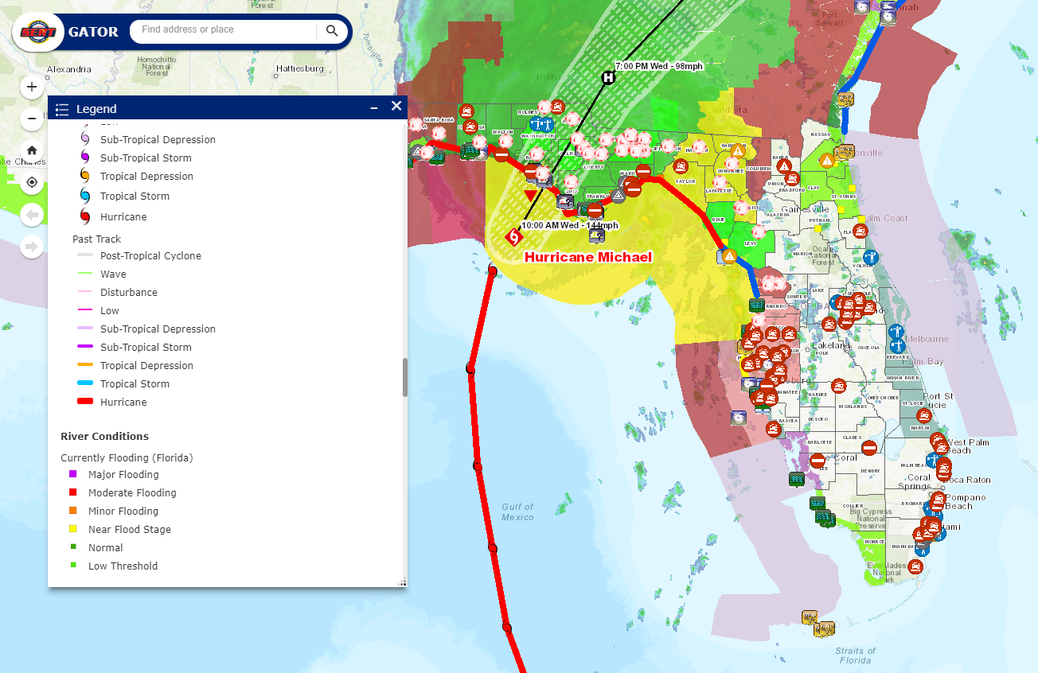
Notes:
https://floridadisaster.maps.arcgis.com/apps/webappviewer/index.html?id=f5628cfc02ca42b4a3853c69d8ff804b

Slide 21
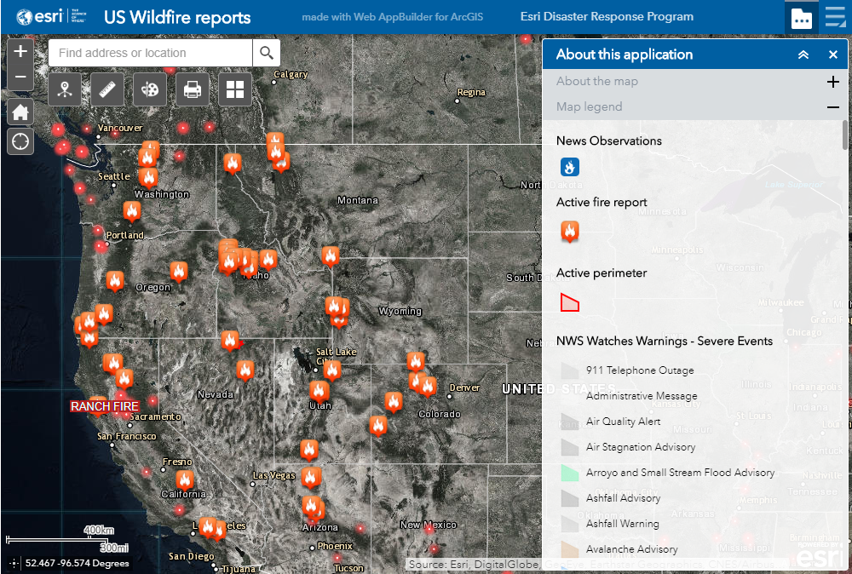
Notes:
https://www.esri.com/en-us/disaster-response/disasters/wildfires

Slide 22
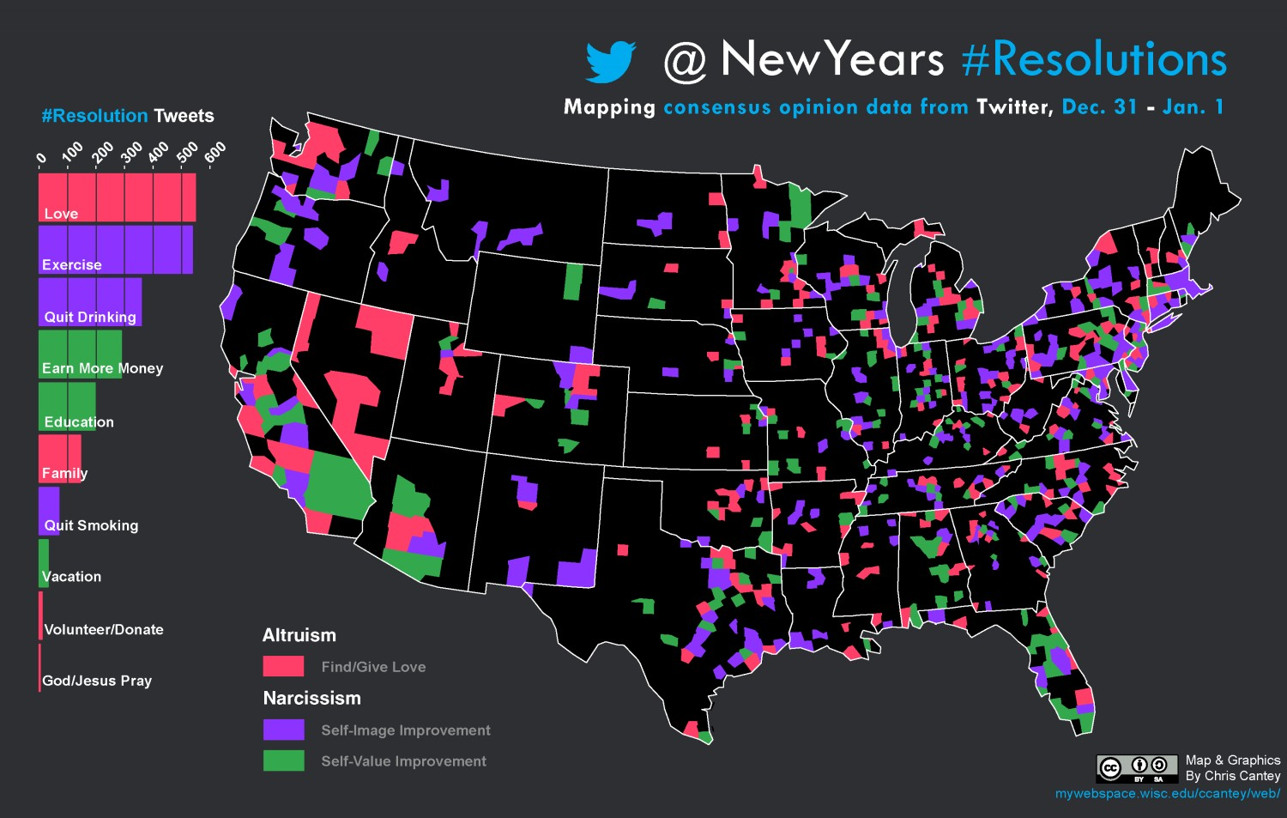
Notes:
https://visual.ly/community/infographic/social-media/new-years-resolution-twitter-map

Slide 23
ArcGIS API for JavaScript

Slide 24
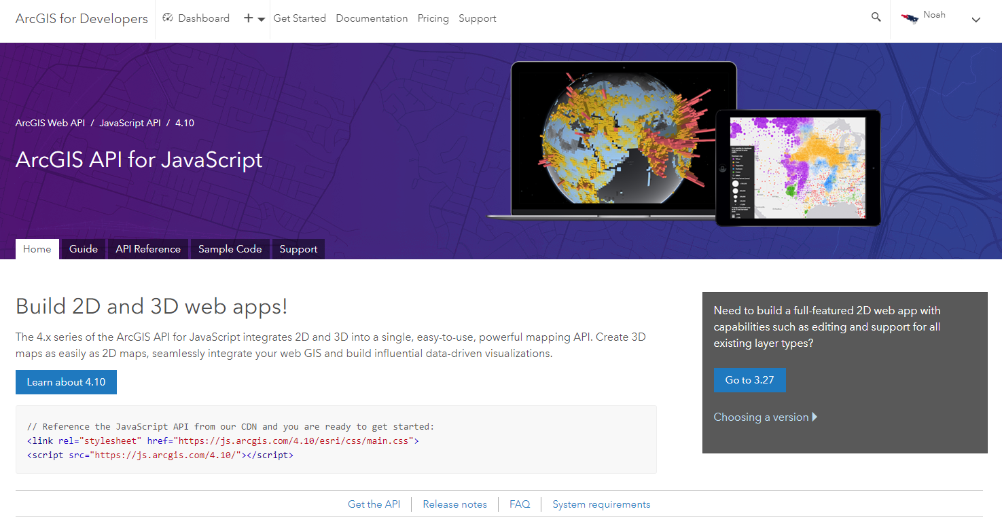
https://developers.arcgis.com/javascript
Notes:
https://developers.arcgis.com/javascript/index.html

Slide 25
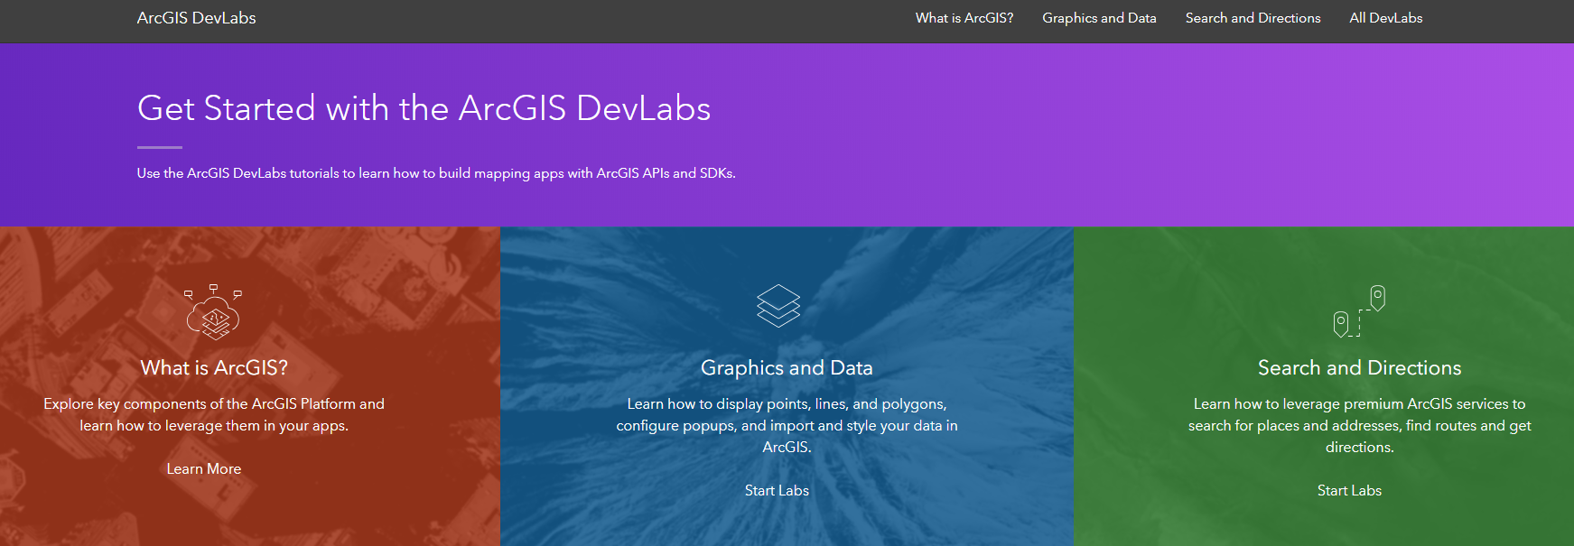
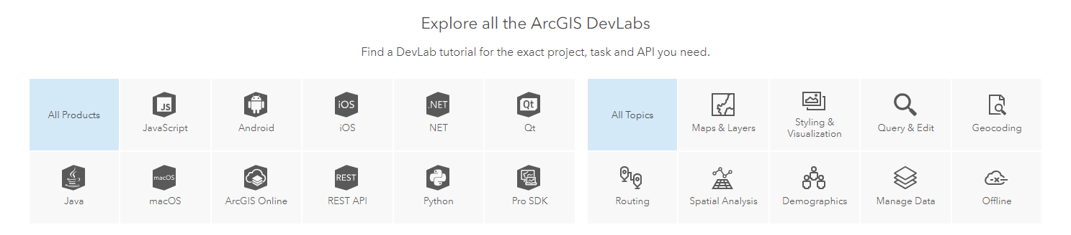
Notes:
https://developers.arcgis.com/labs/

Slide 26
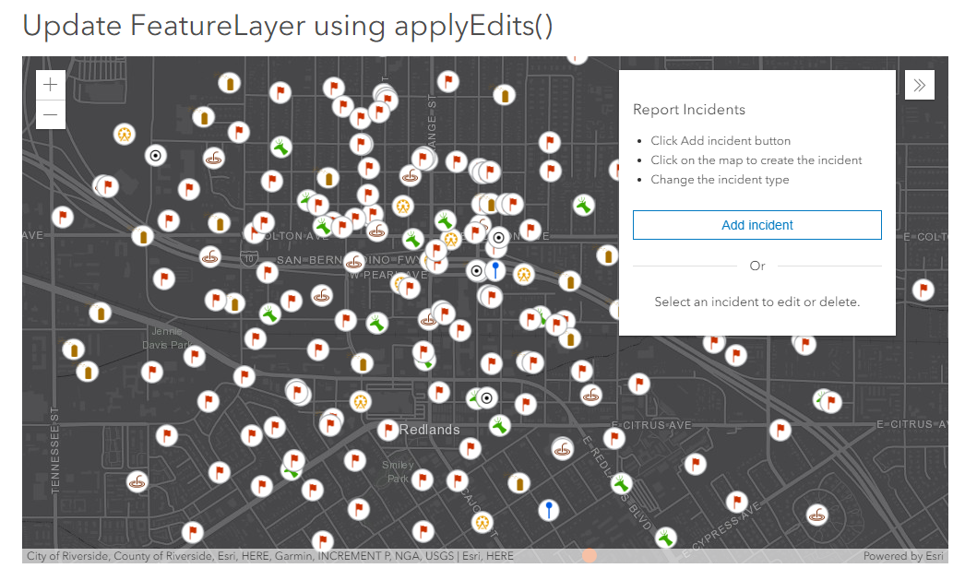
Notes:
https://developers.arcgis.com/javascript/latest/sample-code/editing-applyedits/index.html

Slide 27
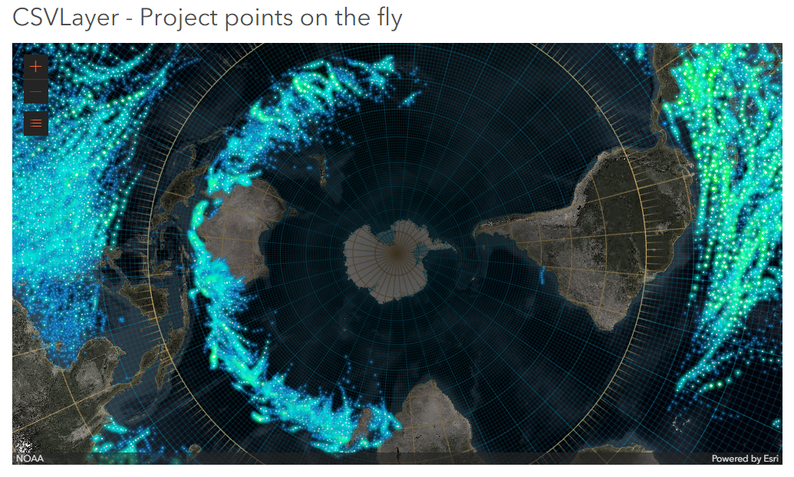
Notes:
https://developers.arcgis.com/javascript/latest/sample-code/layers-csv-projection/index.html

Slide 28
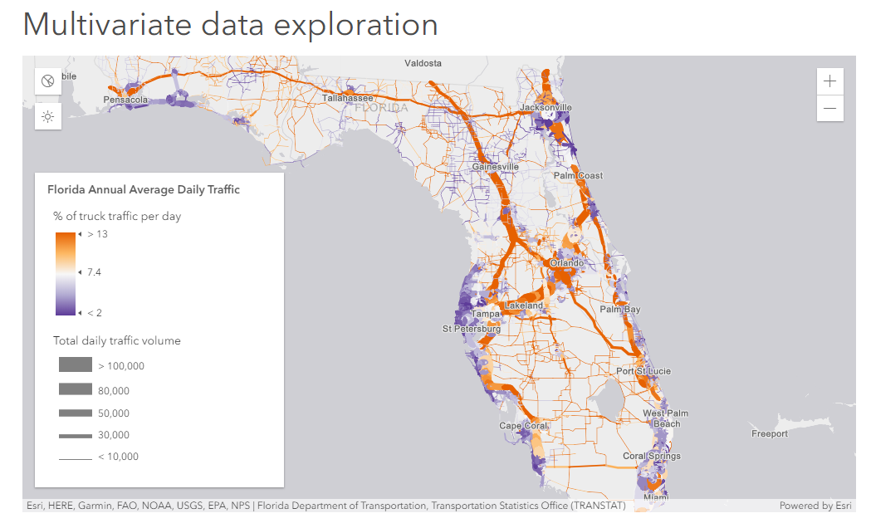
Notes:
https://developers.arcgis.com/javascript/latest/sample-code/visualization-sm-multivariate/index.html

Slide 29
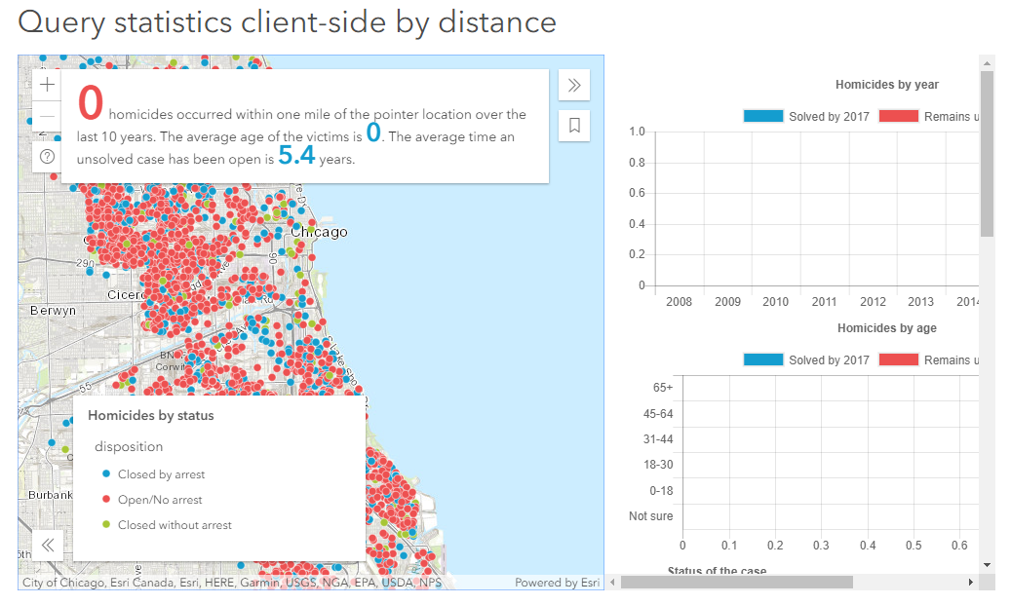
Notes:
https://developers.arcgis.com/javascript/latest/sample-code/featurelayerview-query-distance/index.html

Slide 30
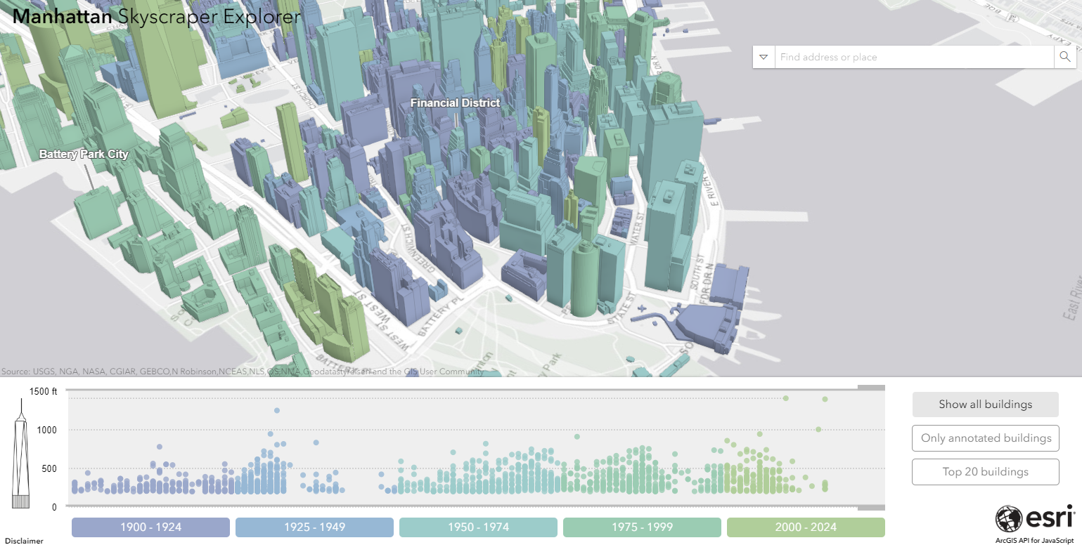
App credit: Raluca Nicola - @nicolaraluk
Notes:
https://esri.github.io/Manhattan-skyscraper-explorer/

Slide 31
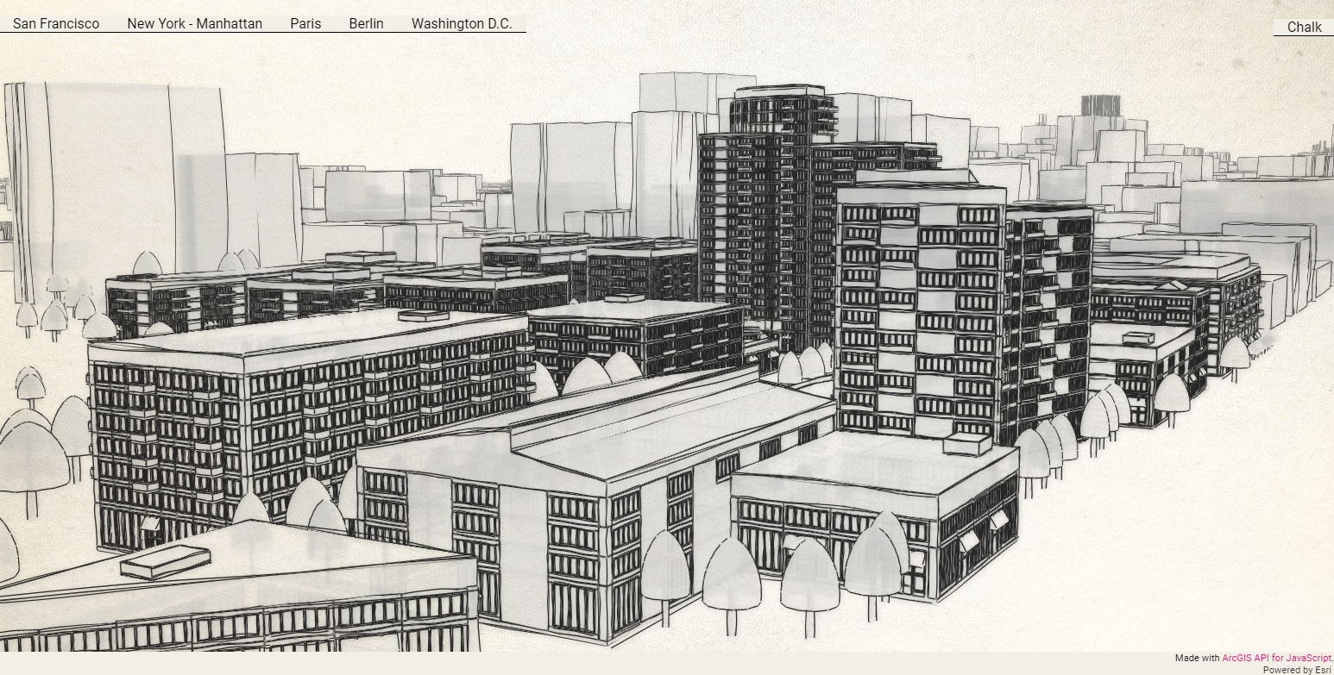
App credit: Raluca Nicola - @nicolaraluk
Notes:
https://ralucanicola.github.io/JSAPI_demos/sketch-the-city/index.html?id=6e0c71260845493ea65b56cc8a3ca5d5

Slide 32
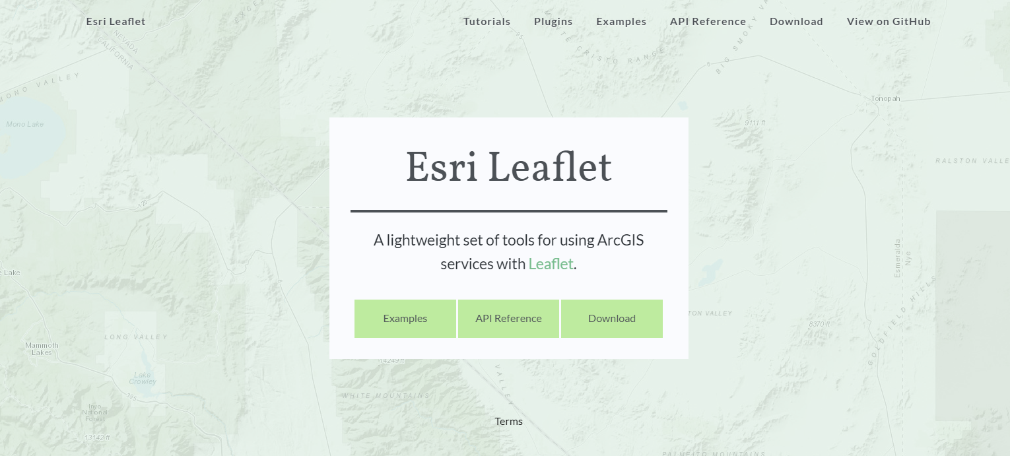
Notes:
http://esri.github.io/esri-leaflet/

Slide 33
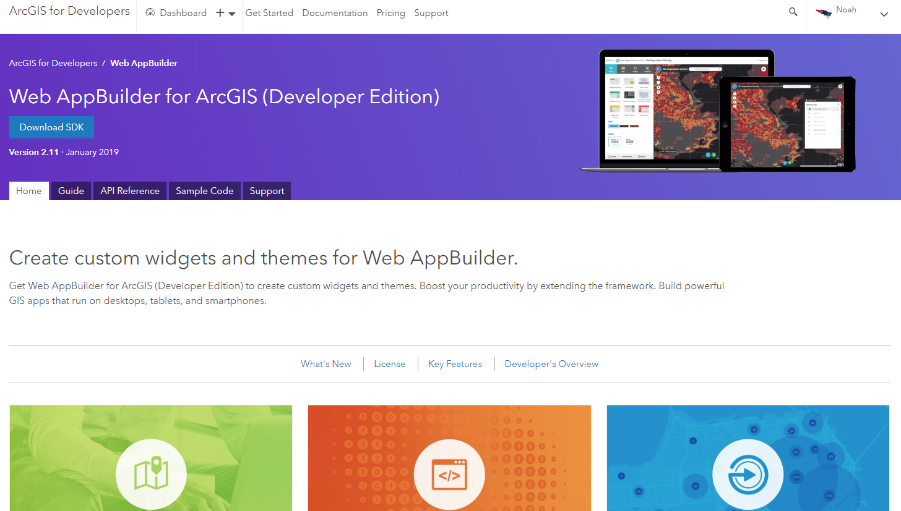
Notes:
https://developers.arcgis.com/web-appbuilder/

Slide 34
Notes:
https://floridadisaster.maps.arcgis.com/apps/webappviewer/index.html?id=f5628cfc02ca42b4a3853c69d8ff804b

Slide 35
Configurable Apps & Templates

Slide 36
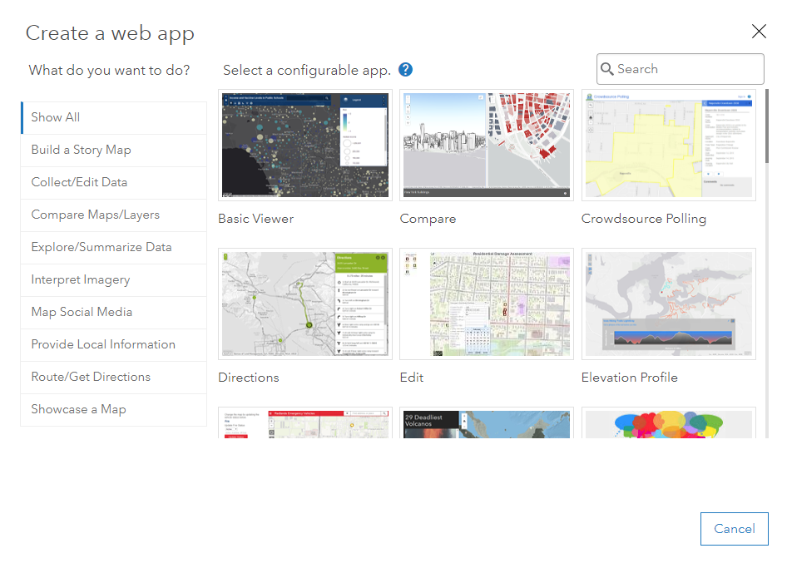
ArcGIS Online
Configurable Apps
App Templates
Story Maps
Notes:
https://doc.arcgis.com/en/arcgis-online/create-maps/choose-configurable-app.htm

Slide 37
Notes:
https://storymaps.arcgis.com/en/

Slide 38
Data

Slide 39
Notes:
https://doc.arcgis.com/en/arcgis-online/reference/supported-items.htm

Slide 40
https://data.ca.gov/
Notes:
https://data.ca.gov/

Slide 41
https://geohub.lacity.org/
Notes:
https://geohub.lacity.org/
https://geohub.lacity.org/datasets/thrift-shops

Slide 42
https://livingatlas.arcgis.com/en/
Notes:
https://livingatlas.arcgis.com/en/

Slide 43
Career Opportunities

Slide 44

https://www.esri.com/en-us/about/careers/student-jobs
Notes:
https://www.esri.com/en-us/about/careers/student-jobs

Slide 45



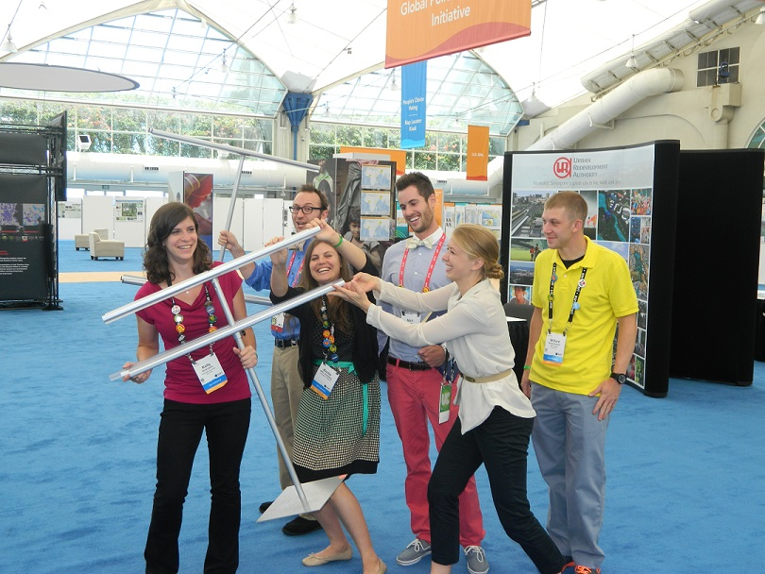

Notes:
http://www.esri.com/events/user-conference

Slide 46

https://community.esri.com/community/esri-young-professionals-network
Notes:
https://community.esri.com/community/esri-young-professionals-network

Slide 47


https://community.esri.com/groups/geodev
@EsriGeoDev
Notes:
https://community.esri.com/groups/geodev
https://twitter.com/EsriGeoDev

Slide 48


https://www.esri.com/en-us/industries/sustainability/nonprofit-program/overview
@Esri_Nonprofit
Notes:
https://www.esri.com/en-us/industries/sustainability/nonprofit-program/overview
https://twitter.com/esri_nonprofit

Slide 49
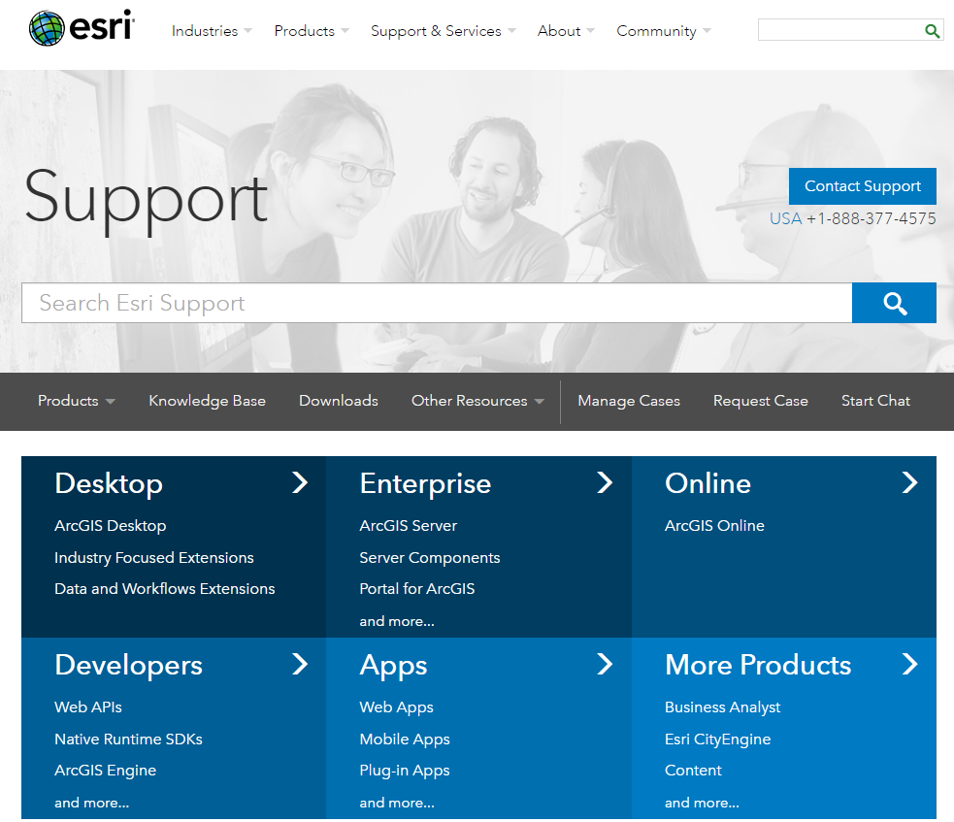
Notes:
http://support.esri.com/

Slide 50
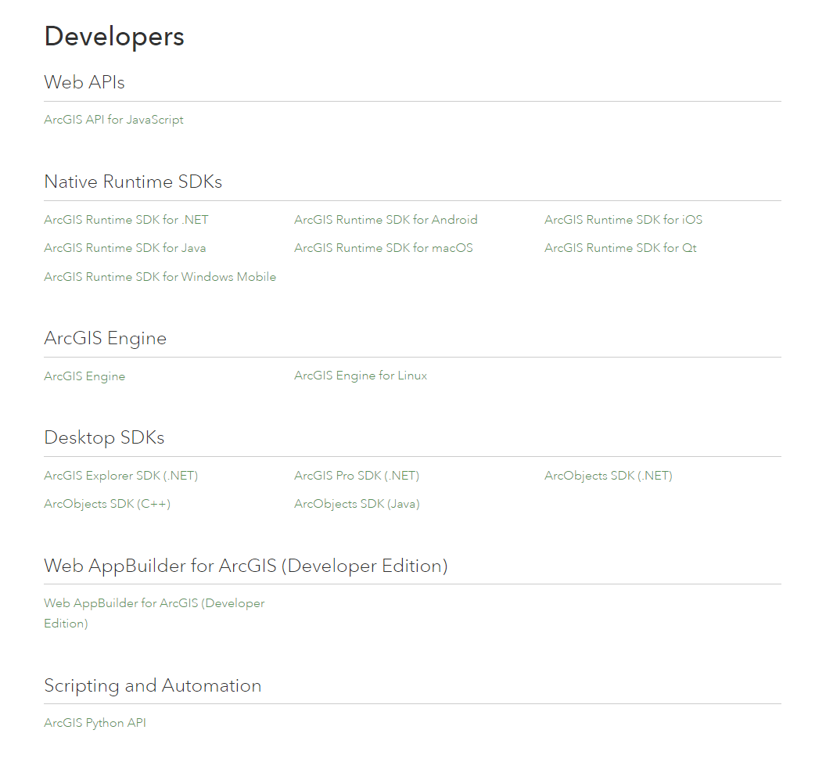
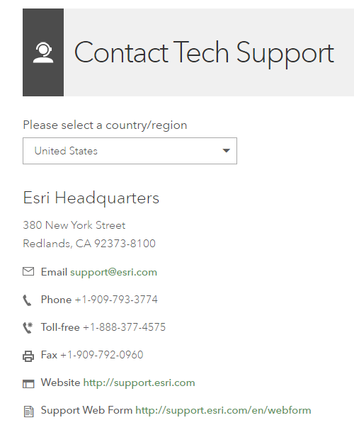
Notes:
http://support.esri.com/Products/Developers

Slide 51


Geomentoring
Notes:
http://www.esri.com/careers/main/student-jobs

Slide 52


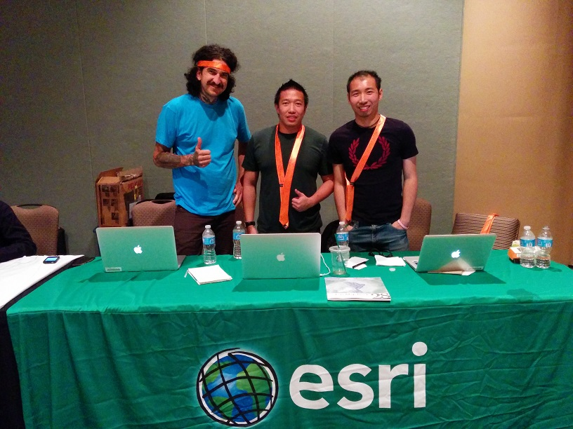
Hackathons
Notes:
Hackathons

Slide 53

Outreach
Notes:
Outreach

Slide 54

https://www.esri.com/training/
Notes:
https://www.esri.com/training/

Slide 55

https://www.esri.com/videos
Notes:
https://www.esri.com/videos

Slide 56
Unsolicited Advice
Notes:
You didn’t ask, but…

Slide 57


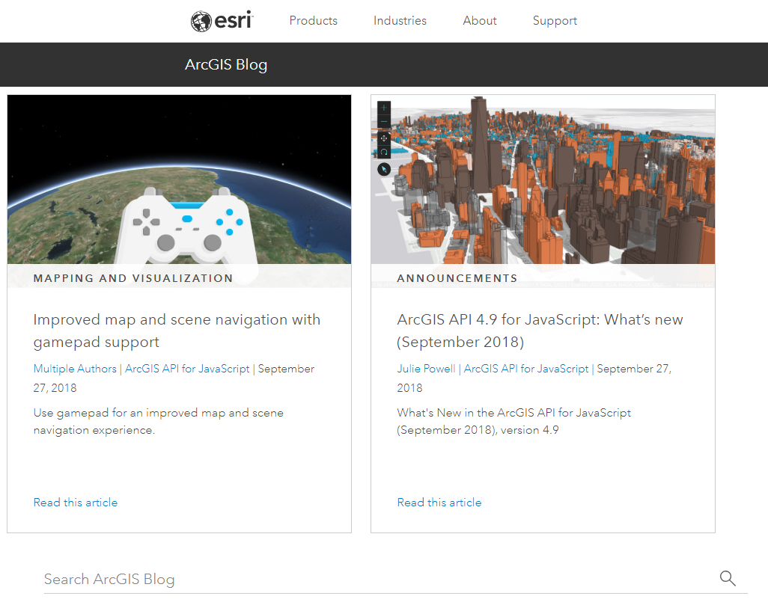
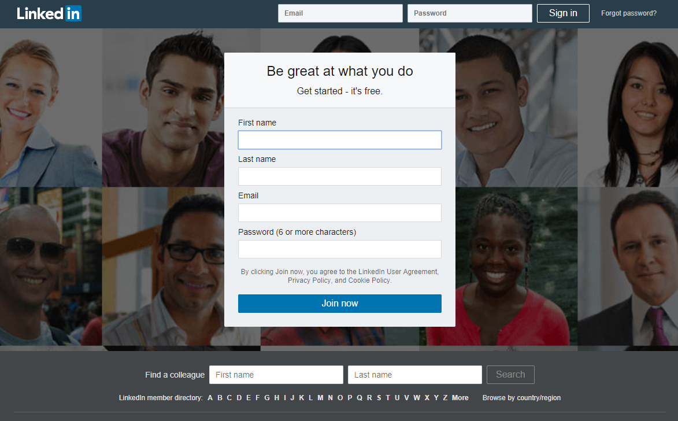

Slide 58
Thank you! Questions?
@noashx
nsager@esri.com

